Slide 1
Ch. 5 Information Privacy
By: Chris Mendoza

Slide 2
Definition of Privacy
Privacy is defined as a social arrangement that allows individuals to have some level of control over who is able to gain access to their physical selves and their personal information

Slide 3
Harms and Benefits of Privacy
Harms of Privacy
Some people use privacy to plan out and carry out illegal or immoral. activities
Families are expected to solve their own problems.
Too much privacy can be a curse to some people.
Benefits of Privacy
Privacy allows us to be ourselves by letting us remove our public persona.
Privacy can foster intellectual activities by allowing us to focus our thoughts without interruptions.

Slide 4
Is There a Natural Right to Privacy
Philosophers for years have disagreed whether there is a natural right to privacy.
Most believe that privacy is a prudential right which means that there is a net benefit to society so members should be allowed to have the right to privacy.

Slide 5

Privacy and Trust
Due to an increase in privacy in today's society we must now have trust in complete strangers.
In order to trust others we must rely on their reputation. Today society must obtain information from a person to establish reputations.
Ways gain information from a person include an ordeal such as a drug test or by requesting credentials such as a driver's license.

Slide 6

Information Disclosures
As we go on with our lives we leave behind an electronic trail of our activities thanks to computerized databases
Some events result in the creation of public records. These include birth certificates, marriage licenses, motor vehicle records, criminal records, and deeds to properties.
Computerized databases and the Internet have made accessing these public records quick and inexpensive.

Slide 7
Benefits and Harms of Computerized Databases
Benefits
Companies are able to pull a criminal record of a person they are hiring.
Before moving to a new city you are able to check the crime rate of the area.
Transportation providers can check the driving records of the employees applying.
Harms
Companies may share your information to other companies that then send you junk mail for products you have no interest in
Employers can hire a company such as Social Intelligence Corporation to run a background check by searching the internet for social media posts by the person applying for a job

Slide 8

Facebook Tags
In December 2010 Facebook introduced Tag Suggestions which uses facial recognition software to suggest the name of a friend appearing in a picture that is uploaded.
In June 2011, the Electronic Privacy Information Center filed a complaint to the FTC claiming that Facebook gathered user’s facial data without their consent.
Others raised the concern that this feature would increase the chance that photos would be improperly tagged.

Slide 9

Enhanced 911 Services
All cell phone providers in the US are required by law to track the location of active cell phone users to within 100 meters.
The benefit of this is that emergency services can reach a person that is unable to speak or do not know where they are.
The main downside is a potential loss of privacy.

Slide 10
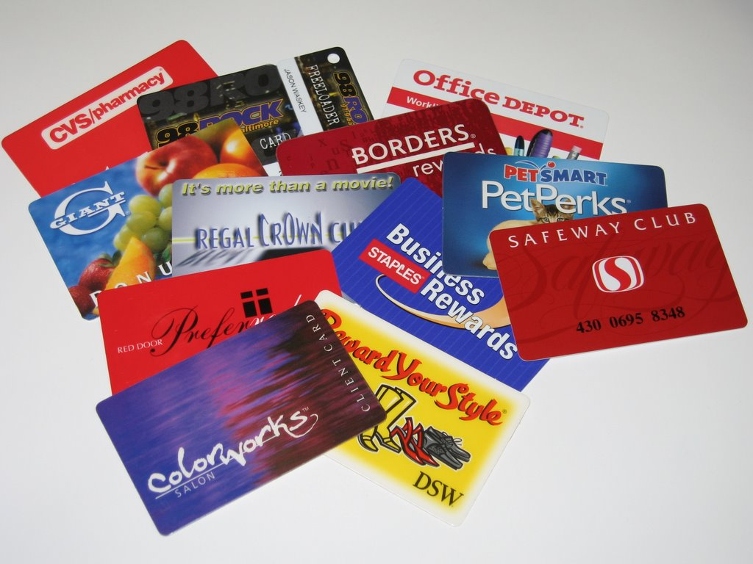
Rewards or Loyalty Programs
Rewards or Loyalty programs for shoppers have been around for more than 100 years.
Computers record every purchase by a member so that companies can use buying habits information of a particular customer to provide them with individualized service.
To protect their personal information some consumers give fake personal information when applying for these programs.

Slide 11
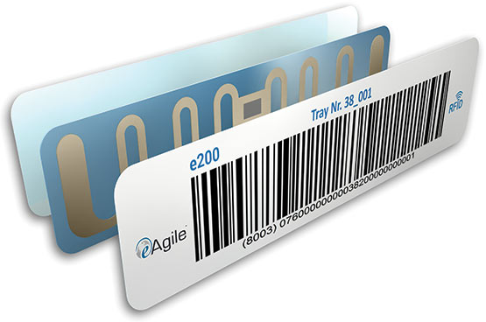
RFID Tags
A tiny wireless transmitter which manufacturers are using to replace bar codes due to checkouts are quicker and companies track their inventory more accurately since a scanner can read an RFID from six feet away.
The main issue is that the RFIDs are not turned off when a customer purchases an item which leads to privacy concerns.

Slide 12
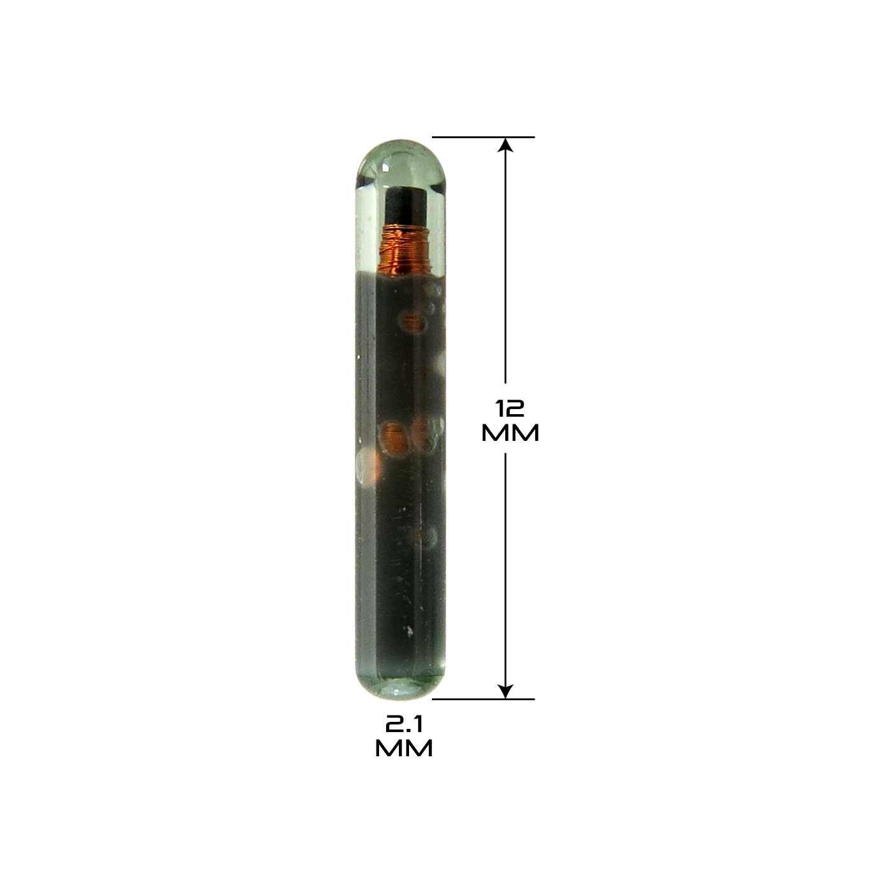
Implanted Chips
In Taiwan domesticated dogs have a small microchip implanted in their ear for easy retrieval in case the dog gets last.
Verichip Corporation created an RFID tag approved for humans and the company claimed that 2000 people worldwide had their chip implanted.

Slide 13


